Slide 1
WhiteMatterSF manual
Gong-Jun Ji
jigongjun@163.com
Anhui Medical University

Slide 2
Introduction
Neuroimage has been used to investigate how the brain works for decades. But only in the past 10 years, fMRI has become a promising way to guide clinical treatment, such as repetitive transcranial stimulation (rTMS) for major depression disorder. In this background, we initiated a Neuroimaging-and-Neruomodulation project that aimed to provide a toolbox connecting imaging findings with rTMS treatment. WhiteMatterSF and TMStarget are two tools generated in this project.
All the code in Neuroimaging-and-Neruomodulation project has been shared at github. You may download them at https://github.com/jigongjun/Neuroimaging-and-Neuromodulation.
This manual is about WhiteMatterSF. The main script could be download at https://github.com/jigongjun/Neuroimaging-and-Neuromodulation/tree/main/WM. Notably, the intact function of WhiteMatterSF need all the scripts of Neuroimaging-and-Neruomodulation project.

Slide 3
Introduction
WhiteMatterSF is a matlab toolbox. To use the full function of this package, you should add additional fMRI tools in your compute.
AFQ: https://github.com/yeatmanlab/AFQ (for bundle-based WM function analysis)
vistasoft: https://github.com/vistalab/vistasoft (for bundle-based WM function analysis)
FSL: https://fsl.fmrib.ox.ac.uk/fsl/fslwiki/
SPM12: https://www.fil.ion.ucl.ac.uk/spm/software/

Slide 4
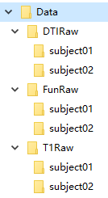
Data preparing
WhiteMatterSF can analyze structural, functional, and duffision images. The DICOM files of different modalities should be listed in different folders as the left figure.
With functional and structure images, we can analyze the white matter function at voxel level [1]. With all the three modalities data, we can investigate the white matter function in particular fiber tracts [2].
References:
[1] Ji GJ, Ren C, Li Y, et al. Regional and network properties of white matter function in parkinson's disease. Hum Brain Mapp, 2019, 40: 1253-1263
[2] Ji GJ, Sun J, Hua Q, et al. White matter dysfunction in psychiatric disorders is associated with neurotransmitter and genetic profiles. Nature Mental Health, 2023, 1: 655-666

Slide 5
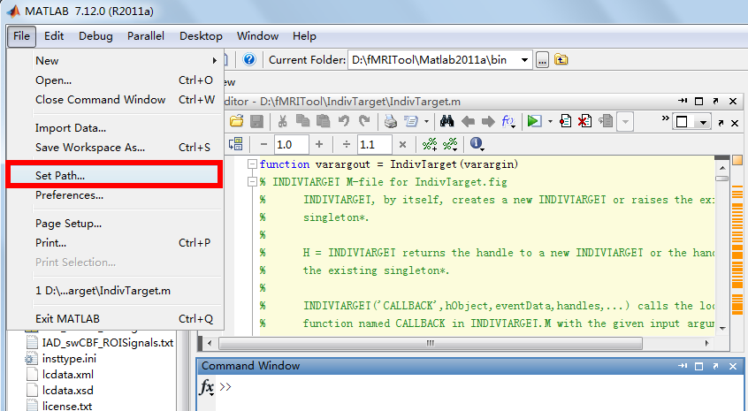
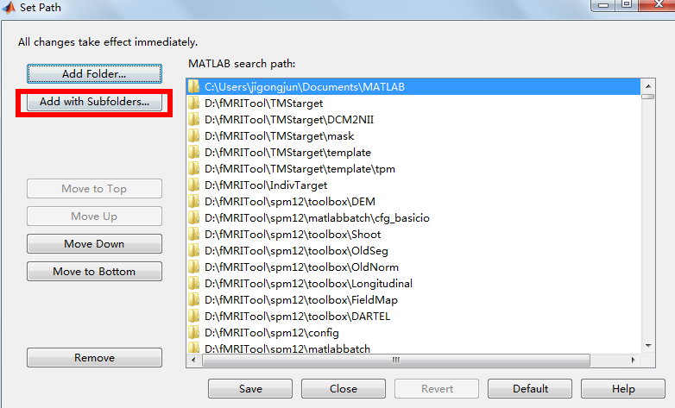

Add all the toolbox on the pathway of Matlab

Slide 6
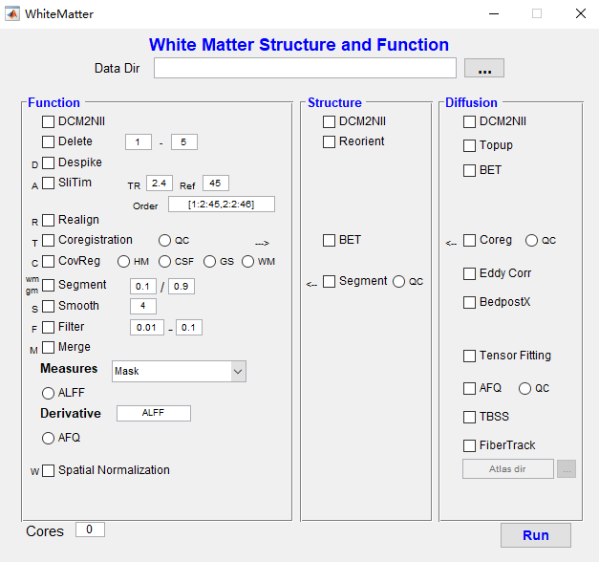

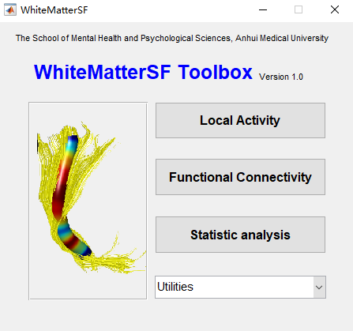
Open the main GUI by typing “WhiteMatterSF”

Slide 7
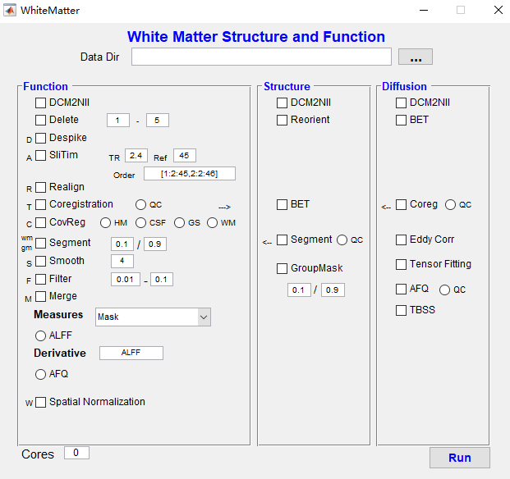
1. Select the data directory with structural images
2. Check all these processings

Slide 8
2. Transform DICOM to Nifti images

Slide 9
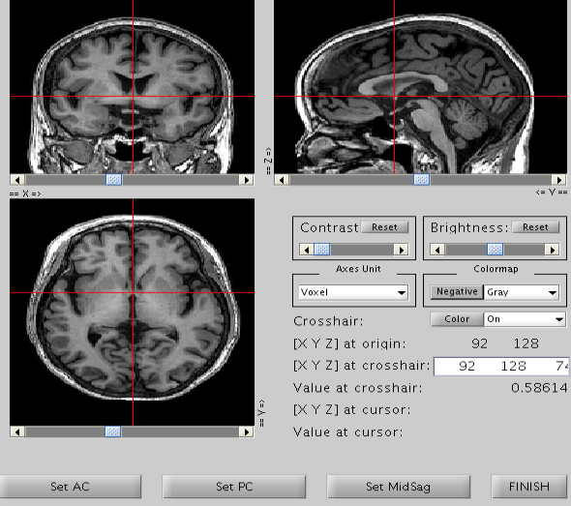
1
2
3
1：select the AC point;
2：select the PC point;
3：select a point in the mid-sagital slice

Slide 10
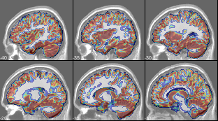
Remove scalp and skin from the images
Segment whole brain to gray and white matter
Figure for quality control

Slide 11
Functional data processing

Slide 12
1. Select the data directory with functional images
2. Check all these processings

Slide 13
Transform DICOM to Nifti images
Delete the first 5 volumes
Delete the sipke time pionts in the signal
Slice timing

Slide 14
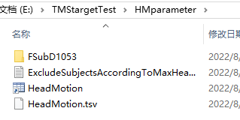
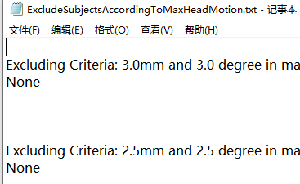
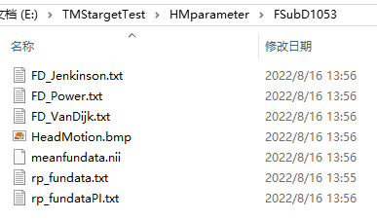
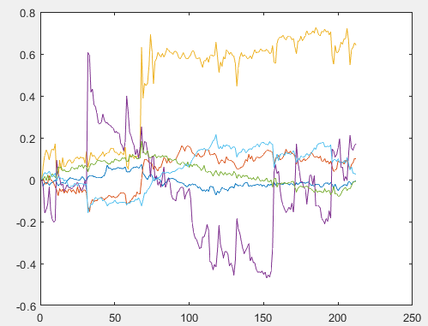
Head motion correction

Slide 15
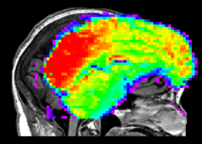
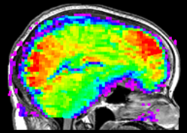
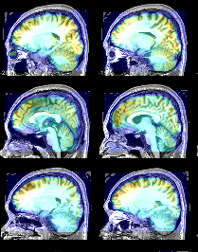
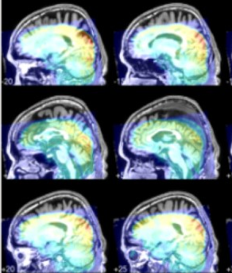
Before coregistration
After coregistration
Coregistration for functional and structure images
QC – successed example
QC – falied example

Slide 16
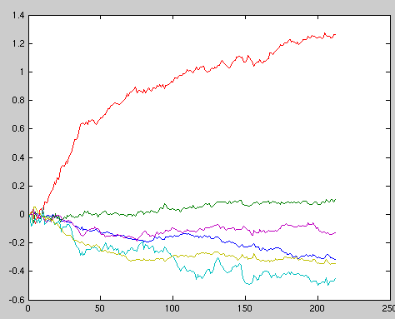
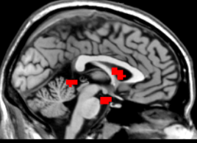
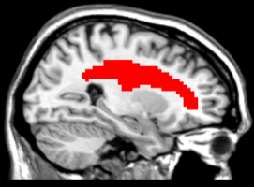
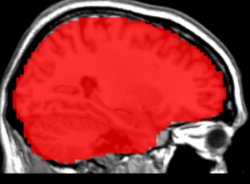
Head motion parameters
√
√
CSF signal
Nusiance regression
X
X
White matter
Global signal

Slide 17
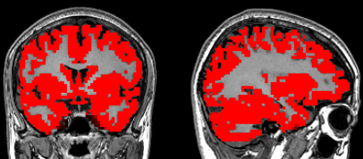
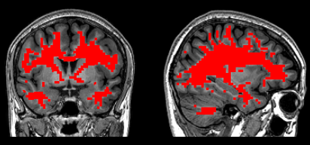
Segment the functional images into gray and white matter parts

Slide 18
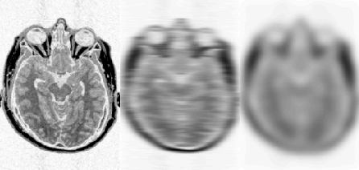
Spatial smoothing
Improves spatial overlap by blurring over minor anatomical differences and registration errors
Averaging neighbouring voxels suppresses noise
Makes data more normally distributed (central limit theorem)

Slide 19
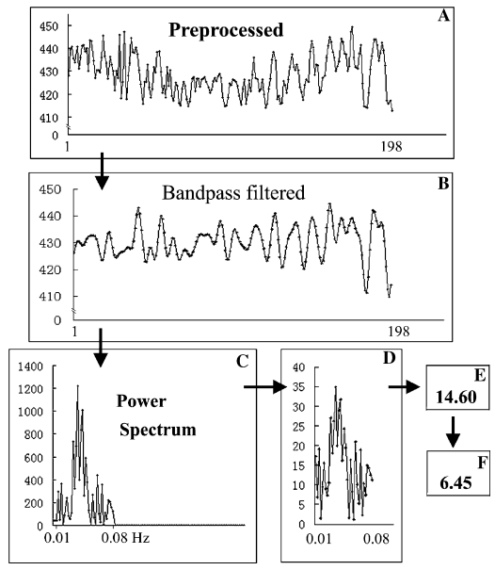
Temporal filter

Slide 20
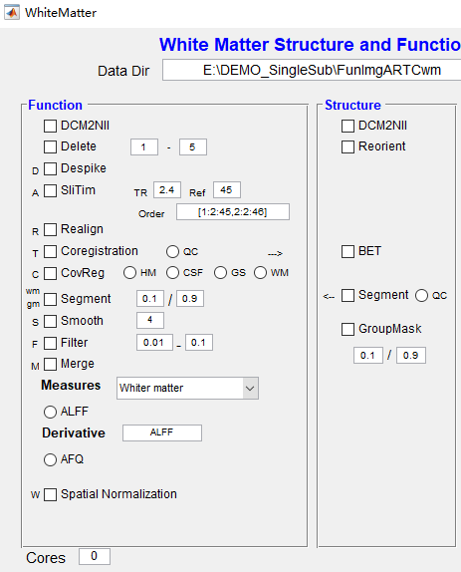
Computing white matter amplitude

Slide 21
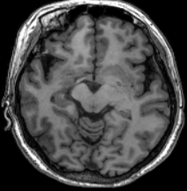
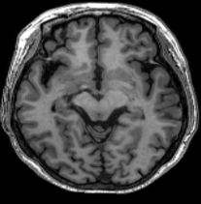
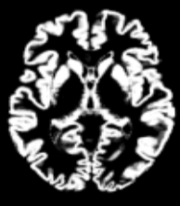
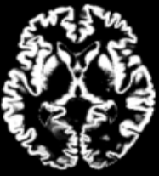
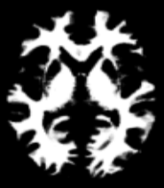
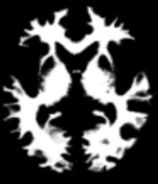
In individual space
In MNI space
Spatial normalization

Slide 22
After transform all the metric images into MNI space, then we can perform statistical analysis on the images.
Since the ‘Statistical Analysis’ is still under developing, we recommand SnPm toolbox and PALM function for statistical inference.
If you aimed to investigate the functional of major fibers, please follow the diffusion analysis from the next slide.

Slide 23
1. Select the data directory with diffusion images
2. Check all these processings

Slide 24
Transform DICOM to Nifti images
Remove scalp and skin from the images
Coregistration for functional and structure images

Slide 25
Correct the image distotion
Using tensor model to compute FA and MD images
Using AFQ toolbox to identify 18 main fibers

Slide 26
After compute the diffusion data and identify the 18 main fibers, you may check this option to compute the function of each fiber using ALFF or other metrics.
Statistical analysis on fibers could be performed in SPASS.

Slide 27
Thanks for reading this manual!

